Slide 1
File Operations

Slide 2
What is a File?
A file is a collection on information, usually stored on a computer’s disk. Information can be saved to files and then later reused.

Slide 3
File Names
All files are assigned a name that is used for identification purposes by the operating system and the user.

Slide 4
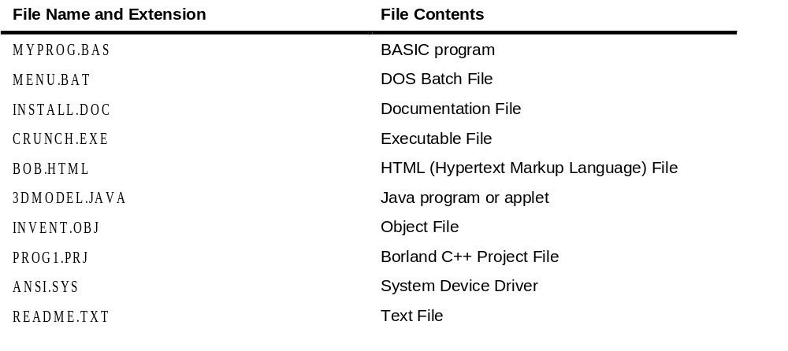
Table

Slide 5
Focus on Software Engineering: The Process of Using a File
Using a file in a program is a simple three-step process
  The file must be opened. If the file does not yet exits, opening it means creating it.
  Information is then saved to the file, read from the file, or both.
  When the program is finished using the file, the file must be closed.

Slide 6
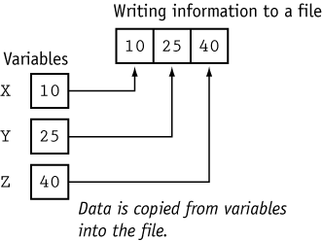
File Writing

Slide 7
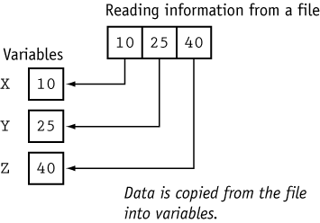
File Reading

Slide 8
Setting Up a Program for File Input/Output
Before file I/O can be performed, a C++ program must be set up properly.
File access requires the inclusion of fstream.h

Slide 9
Opening a File
Before data can be written to or read from a file, the file must be opened.
ifstream inputFile;
inputFile.open(“customer.dat”, <mode>);

Slide 10
Program 1
// This program demonstrates the declaration of an fstream
// object and the opening of a file.
#include <iostream.h>
#include <fstream.h>
void main(void)
{
fstream dataFile; // Declare file stream object
char fileName[81];
cout << "Enter the name of a file you wish to open\n";
cout << "or create: ";
cin.getline(fileName, 81);
dataFile.open(fileName, ios::out);
cout << "The file " << fileName << " was opened.\n";
}

Slide 11
Program Output with Example Input
Enter the name of a file you wish to open
or create: mystuff.dat [Enter]
The file mystuff.dat was opened.

Slide 12
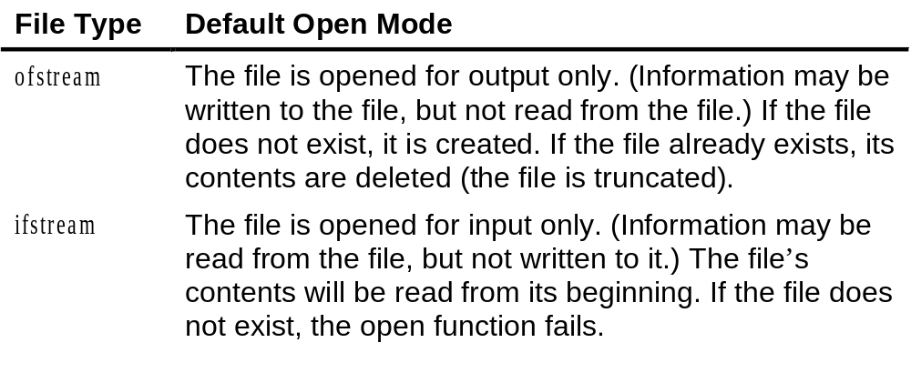
Table 2

Slide 13
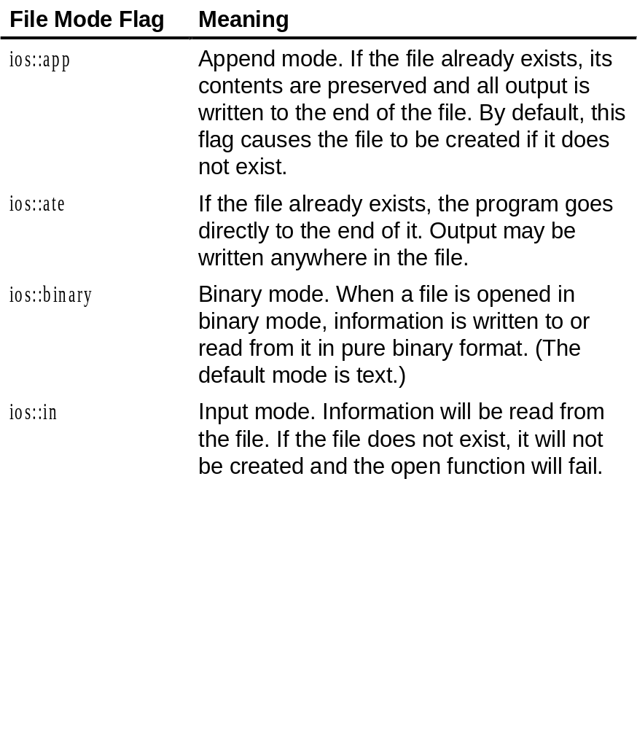
Table 3

Slide 14
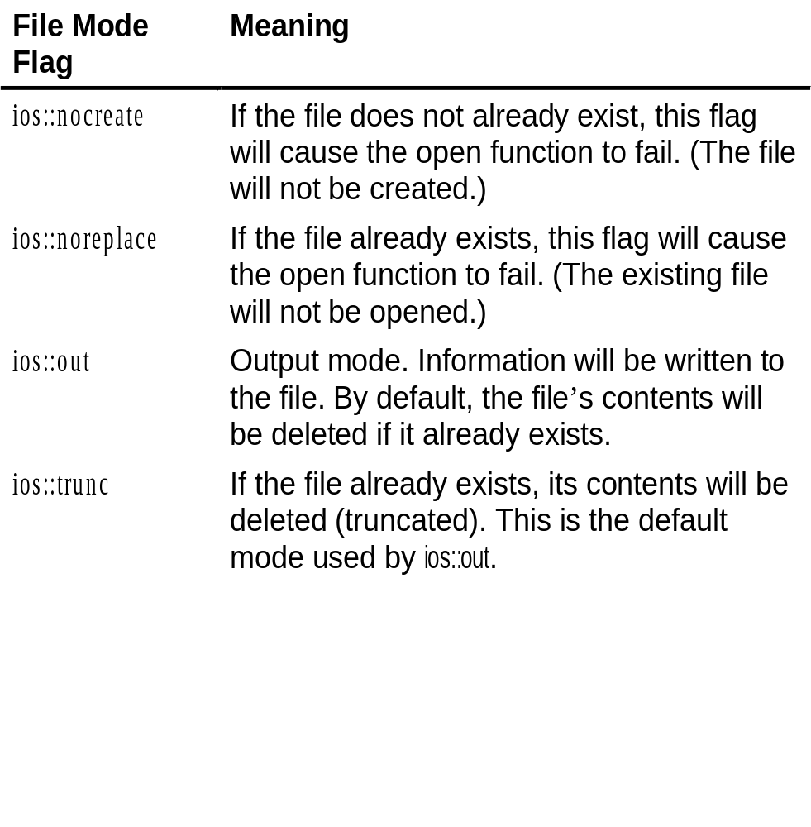
Table 3 continued

Slide 15
Opening a File at Declaration
fstream dataFile(“names.dat”, ios::in | ios::out);

Slide 16
Program 2
// This program demonstrates the opening of a file at the
// time the file stream object is declared.
#include <iostream.h>
#include <fstream.h>
void main(void)
{
fstream dataFile("names.dat", ios::in | ios::out);
cout << "The file names.dat was opened.\n";
}

Slide 17
Program Output with Example Input
The file names.dat was opened.

Slide 18
Testing for Open Errors
dataFile.open(“cust.dat”, ios::in);
if (!dataFile)
{
cout << “Error opening file.\n”;
}

Slide 19
Another way to Test for Open Errors
dataFile.open(“cust.dat”, ios::in);
if (dataFile.fail())
{
cout << “Error opening file.\n”;
}

Slide 20
Closing a File
A file should be closed when a program is finished using it.

Slide 21
Program 3
// This program demonstrates the close function.
#include <iostream.h>
#include <fstream.h>
void main(void)
{
fstream dataFile;
dataFile.open("testfile.txt", ios::out);
if (!dataFile)
{
cout << "File open error!" << endl;
return;
}
cout << "File was created successfully.\n";
cout << "Now closing the file.\n";
dataFile.close();
}

Slide 22
Program Output
File was created successfully.
Now closing the file.

Slide 23
Using << to Write Information to a File
The stream insertion operator (<<) may be used to write information to a file.
    outputFile << “I love C++ programming !”

Slide 24
Program 4
// This program uses the << operator to write information to a file.
#include <iostream.h>
#include <fstream.h>
void main(void)
{
fstream dataFile;
char line[81];
dataFile.open("demofile.txt", ios::out);
if (!dataFile)
{
cout << "File open error!" << endl;
return;
}

Slide 25
Program continues
cout << "File opened successfully.\n";
cout << "Now writing information to the file.\n";
dataFile << "Jones\n";
dataFile << "Smith\n";
dataFile << "Willis\n";
dataFile << "Davis\n";
dataFile.close();
cout << "Done.\n";
}

Slide 26
Program Screen Output
File opened successfully.
Now writing information to the file.
Done.
Output to File demofile.txt
Jones
Smith
Willis
Davis

Slide 27

Contents of File

Slide 28
Program 5
// This program writes information to a file, closes the file,
// then reopens it and appends more information.
#include <iostream.h>
#include <fstream.h>
void main(void)
{
fstream dataFile;
dataFile.open("demofile.txt", ios::out);
dataFile << "Jones\n";
dataFile << "Smith\n";
dataFile.close();
dataFile.open("demofile.txt", ios::app|ios::out);
dataFile << "Willis\n";
dataFile << "Davis\n";
dataFile.close();
}

Slide 29
Output to File demofile.txt
Jones
Smith
Willis
Davis

Slide 30
File Output Formatting
File output may be formatted the same way as screen output.

Slide 31
Program 6
// This program uses the precision member function of a
// file stream object to format file output.
#include <iostream.h>
#include <fstream.h>
void main(void)
{
fstream dataFile;
float num = 123.567;
dataFile.open("numfile.txt", ios::out);
if (!dataFile)
{
cout << "File open error!" << endl;
return;
}

Slide 32
Program continues
dataFile << num << endl;
dataFile.precision(5);
dataFile << num << endl;
dataFile.precision(4);
dataFile << num << endl;
dataFile.precision(3);
dataFile << num << endl;
}

Slide 33
Contents of File numfile.txt
123.567
123.57
123.6
124

Slide 34
Program 7
#include <iostream.h>
#include <fstream.h>
#include <iomanip.h>
void main(void)
{ fstream outFile("table.txt", ios::out);
int nums[3][3] = { 2897, 5, 837,
34, 7, 1623,
390, 3456, 12 };
// Write the three rows of numbers
for (int row = 0; row < 3; row++)
{
for (int col = 0; col < 3; col++)
{
outFile << setw(4) << nums[row][col] << " ";
}
outFile << endl;
}
outFile.close();
}

Slide 35
Contents of File TABLE.TXT
2897 5 837
34 7 1623
390 3456 12

Slide 36
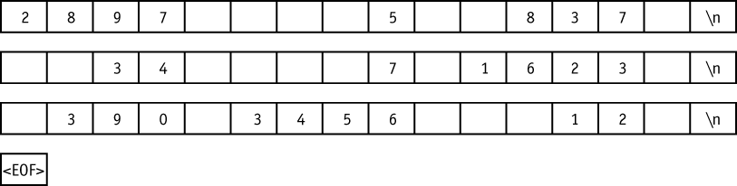
Figure 6

Slide 37
Using >> to Read Information from a File
The stream extraction operator (>>) may be used to read information from a file.

Slide 38
Program 8
// This program uses the >> operator to read information from a file.
#include <iostream.h>
#include <fstream.h>
void main(void)
{
fstream dataFile;
char name[81];
dataFile.open("demofile.txt", ios::in);
if (!dataFile)
{
cout << "File open error!" << endl;
return;
}
cout << "File opened successfully.\n";
cout << "Now reading information from the file.\n\n";

Slide 39
Program continues
for (int count = 0; count < 4; count++)
{
dataFile >> name;
cout << name << endl;
}
dataFile.close();
cout << "\nDone.\n";
}

Slide 40
Program Screen Output
File opened successfully.
Now reading information from the file.
Jones
Smith
Willis
Davis
Done.

Slide 41
Detecting the End of a File
The eof() member function reports when the end of a file has been encountered.
    if (inFile.eof())
    inFile.close();

Slide 42
Program 9
// This program uses the file stream object's eof() member
// function to detect the end of the file.
#include <iostream.h>
#include <fstream.h>
void main(void)
{
fstream dataFile;
char name[81];
dataFile.open("demofile.txt", ios::in);
if (!dataFile)
{
cout << "File open error!" << endl;
return;
}
cout << "File opened successfully.\n";
cout << "Now reading information from the file.\n\n";

Slide 43
Program continues
dataFile >> name; // Read first name from the file
while (!dataFile.eof())
{
cout << name << endl;
dataFile >> name;
}
dataFile.close();
cout << "\nDone.\n";
}

Slide 44
Program Screen Output
File opened successfully.
Now reading information from the file.
Jones
Smith
Willis
Davis
Done.

Slide 45
Note on eof()
The eof() function returns true when there is no more information to be read.

Slide 46
More Detailed Error Testing
All stream objects have error state bits that indicate the condition of the stream.

Slide 47
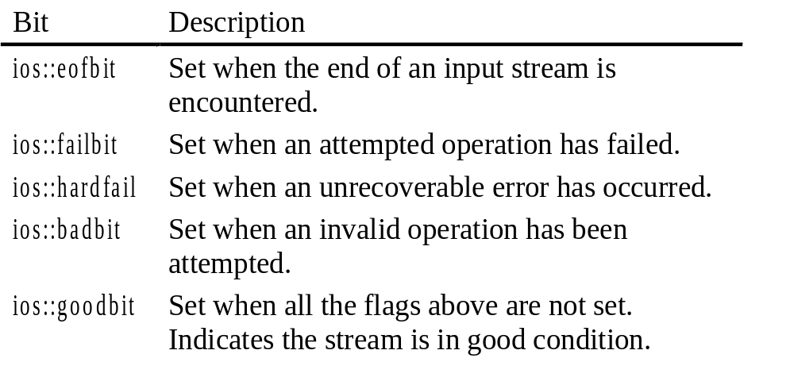
Table 5

Slide 48
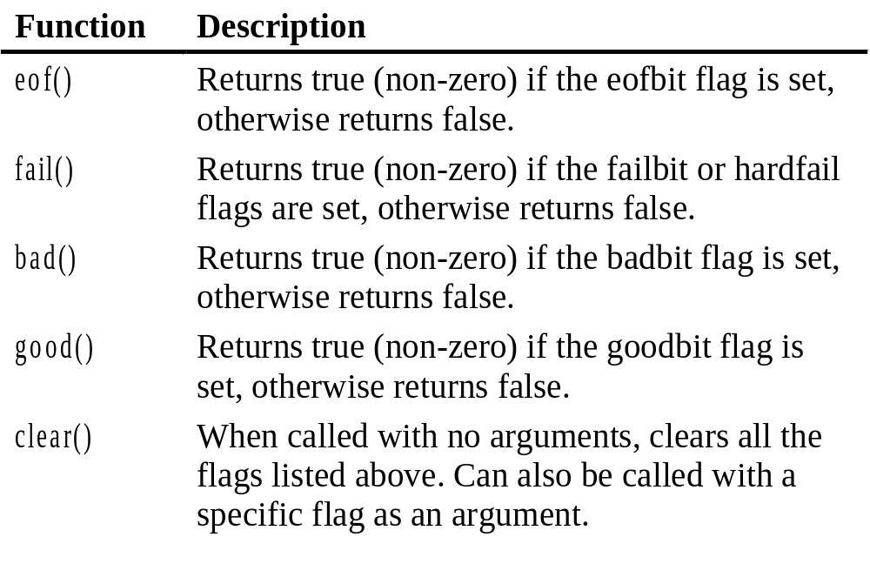
Table 6

Slide 49
Program 11
// This program demonstrates the return value of the stream
// object error testing member functions.
#include <iostream.h>
#include <fstream.h>
// Function prototype
void showState(fstream &);
void main(void)
{
fstream testFile("stuff.dat", ios::out);
if (testFile.fail())
{
cout << "cannot open the file.\n";
return;
}

Slide 50
Program continues
int num = 10;
cout << "Writing to the file.\n";
testFile << num; // Write the integer to testFile
showState(testFile);
testFile.close(); // Close the file
testFile.open("stuff.dat", ios::in); // Open for input
if (testFile.fail())
{
cout << "cannot open the file.\n";
return;
}

Slide 51
Program continues
cout << "Reading from the file.\n";
showState(testFile);
testFile >> num; // Read the only number in the file
cout << "Forcing a bad read operation.\n";
testFile >> num; // Force an invalid read operation
showState(testFile);
testFile.close(); // Close the file
}
// Definition of function ShowState. This function uses
// an fstream reference as its parameter. The return values of
// the eof(), fail(), bad(), and good() member functions are
// displayed. The clear() function is called before the function
// returns.

Slide 52
Program continues
void showState(fstream &file)
{
cout << "File Status:\n";
cout << " eof bit: " << file.eof() << endl;
cout << " fail bit: " << file.fail() << endl;
cout << " bad bit: " << file.bad() << endl;
cout << " good bit: " << file.good() << endl;
file.clear(); // Clear any bad bits
}

Slide 53
Program Output
Writing to the file.
File Status:
eof bit: 0
fail bit: 0
bad bit: 0
good bit: 1
Reading from the file.
File Status:
eof bit: 0
fail bit: 0
bad bit: 0
good bit: 1
Forcing a bad read operation.
File Status:
eof bit: 1
fail bit: 2
bad bit: 0
good bit: 0

Slide 54
Member Functions for Reading and Writing Files
File stream objects have member functions for more specialized file reading and writing.

Slide 55
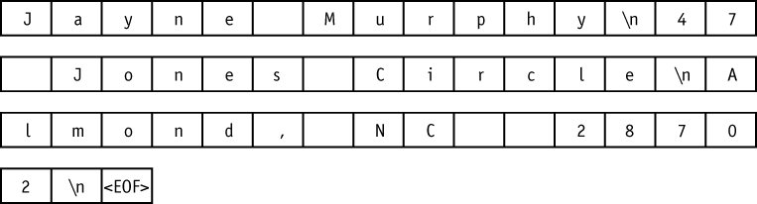
Figure 8

Slide 56
Program 12
// This program uses the file stream object's eof() member
// function to detect the end of the file.
#include <iostream.h>
#include <fstream.h>
void main(void)
{
fstream nameFile;
char input[81];
nameFile.open("murphy.txt", ios::in);
if (!nameFile)
{
cout << "File open error!" << endl;
return;
}

Slide 57
Program 12 (continued)
nameFile >> input;
while (!nameFile.eof())
{
cout << input;
nameFile >> input;
}
nameFile.close();
}

Slide 58
Program Screen Output
JayneMurphy47JonesCircleAlmond,NC28702

Slide 59
The getline Member Function
dataFile.getline(str, 81, ‘\n’);
    str – This is the name of a character array, or a pointer to a section of memory. The information read from the file will be stored here.
    81 – This number is one greater than the maximum number of characters to be read. In this example, a maximum of 80 characters will be read.
    ‘\n’ – This is a delimiter character of your choice. If this delimiter is encountered, it will cause the function to stop reading before it has read the maximum number of characters. (This argument is optional. If it’s left our, ‘\n’ is the default.)

Slide 60
Program 13
// This program uses the file stream object's getline member
// function to read a line of information from the file.
#include <iostream.h>
#include <fstream.h>
void main(void)
{
fstream nameFile;
char input[81];
nameFile.open("murphy.txt", ios::in);
if (!nameFile)
{
cout << "File open error!" << endl;
return;
}

Slide 61
Program continues
nameFile.getline(input, 81); // use \n as a delimiter
while (!nameFile.eof())
{
cout << input << endl;
nameFile.getline(input, 81); // use \n as a delimiter
}
nameFile.close();
}

Slide 62
Program Screen Output
Jayne Murphy
47 Jones Circle
Almond, NC 28702

Slide 63
Program 14
// This file shows the getline function with a user-
// specified delimiter.
#include <iostream.h>
#include <fstream.h>
void main(void)
{
fstream dataFile("names2.txt", ios::in);
char input[81];
dataFile.getline(input, 81, '$');
while (!dataFile.eof())
{
cout << input << endl;
dataFile.getline(input, 81, '$');
}
dataFile.close();
}

Slide 64
Program Output
Jayne Murphy
47 Jones Circle
Almond, NC 28702
Bobbie Smith
217 Halifax Drive
Canton, NC 28716
Bill Hammet
PO Box 121
Springfield, NC 28357

Slide 65
The get Member Function
inFile.get(ch);

Slide 66
Program 15
// This program asks the user for a file name. The file is
// opened and its contents are displayed on the screen.
#include <iostream.h>
#include <fstream.h>
void main(void)
{
fstream file;
char ch, fileName[51];
cout << "Enter a file name: ";
cin >> fileName;
file.open(fileName, ios::in);
if (!file)
{
cout << fileName << “ could not be opened.\n";
return;
}

Slide 67
Program continues
file.get(ch); // Get a character
while (!file.eof())
{
cout << ch;
file.get(ch); // Get another character
}
file.close();
}

Slide 68
The put Member Function
outFile.put(ch);

Slide 69
Program 16
// This program demonstrates the put member function.
#include <iostream.h>
#include <fstream.h>
void main(void)
{ fstream dataFile("sentence.txt", ios::out);
char ch;
cout << "Type a sentence and be sure to end it with a ";
cout << "period.\n";
while (1)
{
cin.get(ch);
dataFile.put(ch);
if (ch == '.')
break;
}
dataFile.close();
}

Slide 70
Program Screen Output with Example Input
Type a sentence and be sure to end it with a
period.
I am on my way to becoming a great programmer. [Enter]
Resulting Contents of the File SENTENCE.TXT:
I am on my way to becoming a great programmer.

Slide 71
Focus on Software Engineering: Working with Multiple Files
It’s possible to have more than one file open at once in a program.

Slide 72
Program 17
// This program demonstrates reading from one file and writing
// to a second file.
#include <iostream.h>
#include <fstream.h>
#include <ctype.h> // Needed for the toupper function
void main(void)
{
ifstream inFile;
ofstream outFile("out.txt");
char fileName[81], ch, ch2;
cout << "Enter a file name: ";
cin >> fileName;
inFile.open(fileName);
if (!inFile)
{
cout << "Cannot open " << fileName << endl;
return;
}

Slide 73
Program continues
inFile.get(ch); // Get a characer from file 1
while (!inFile.eof()) // Test for end of file
{
ch2 = toupper(ch); // Convert to uppercase
outFile.put(ch2); // Write to file2
inFile.get(ch); // Get another character from file 1
}
inFile.close();
outFile.close();
cout << "File conversion done.\n";
}

Slide 74
Program Screen Output with Example Input
Enter a file name: hownow.txt [Enter]
File conversion done.
Contents of hownow.txt:
how now brown cow.
How Now?
Resulting Contents of out.txt:
HOW NOW BROWN COW.
HOW NOW?

Slide 75
Binary Files
Binary files contain data that is unformatted, and not necessarily stored as ASCII text.
  file.open(“stuff.dat”, ios::out | ios::binary);

Slide 76
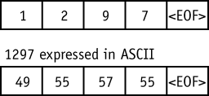
Figure 9
57

Slide 77
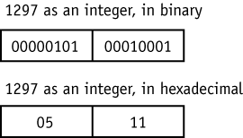
Figure 10

Slide 78
Program 18
// This program uses the write and read functions.
#include <iostream.h>
#include <fstream.h>
void main(void)
{
fstream file(“NUMS.DAT", ios::out | ios::binary);
int buffer[10] = {1, 2, 3, 4, 5, 6, 7, 8, 9, 10};
cout << "Now writing the data to the file.\n";
file.write((char*)buffer, sizeof(buffer));
file.close();
file.open("NUMS.DAT", ios::in); // Reopen the file.
cout << "Now reading the data back into memory.\n";
file.read((char*)buffer, sizeof(buffer));
for (int count = 0; count < 10; count++)
cout << buffer[count] << " ";
file.close();
}

Slide 79
Program Screen Output
Now writing the data to the file.
Now reading the data back into memory.
1 2 3 4 5 6 7 8 9 10

Slide 80
16 Creating Records with Structures
Structures may be used to store fixed-length records to a file.
      struct Info
      {
      char name[51];
      int age;
      char address1[51];
      char address2[51];
      char phone[14];
      };
Since structures can contain a mixture of data types, you should always use the ios::binary mode when opening a file to store them.

Slide 81
Program 19
// This program demonstrates the use of a structure variable to
// store a record of information to a file.
#include <iostream.h>
#include <fstream.h>
#include <ctype.h> // for toupper
// Declare a structure for the record.
struct Info
{
char name[51];
int age;
char address1[51];
char address2[51];
char phone[14];
};

Slide 82
Program continues
void main(void)
{
fstream people("people.dat", ios::out | ios::binary);
Info person;
char again;
if (!people)
{
cout << "Error opening file. Program aborting.\n";
return;
}
do
{
cout << "Enter the following information about a ”
<< "person:\n";
cout << "Name: ";

Slide 83
Program continues
cin.getline(person.name, 51);
cout << "Age: ";
cin >> person.age;
cin.ignore(); // skip over remaining newline.
cout << "Address line 1: ";
cin.getline(person.address1, 51);
cout << "Address line 2: ";
cin.getline(person.address2, 51);
cout << "Phone: ";
cin.getline(person.phone, 14);
people.write((char *)&person, sizeof(person));
cout << "Do you want to enter another record? ";
cin >> again;
cin.ignore();
} while (toupper(again) == 'Y');
people.close();
}

Slide 84
Program Screen Output with Example Input
Enter the following information about a person:
Name: Charlie Baxter [Enter]
Age: 42 [Enter]
Address line 1: 67 Kennedy Bvd. [Enter]
Address line 2: Perth, SC 38754 [Enter]
Phone: (803)555-1234 [Enter]
Do you want to enter another record? Y [Enter]
Enter the following information about a person:
Name: Merideth Murney [Enter]
Age: 22 [Enter]
Address line 1: 487 Lindsay Lane [Enter]
Address line 2: Hazelwood, NC 28737 [Enter]
Phone: (704)453-9999 [Enter]
Do you want to enter another record? N [Enter]

Slide 85
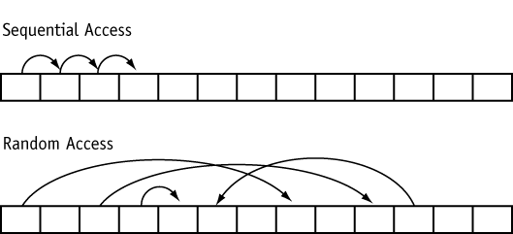
Random Access Files
Random Access means non-sequentially accessing informaiton in a file.
Figure 11

Slide 86
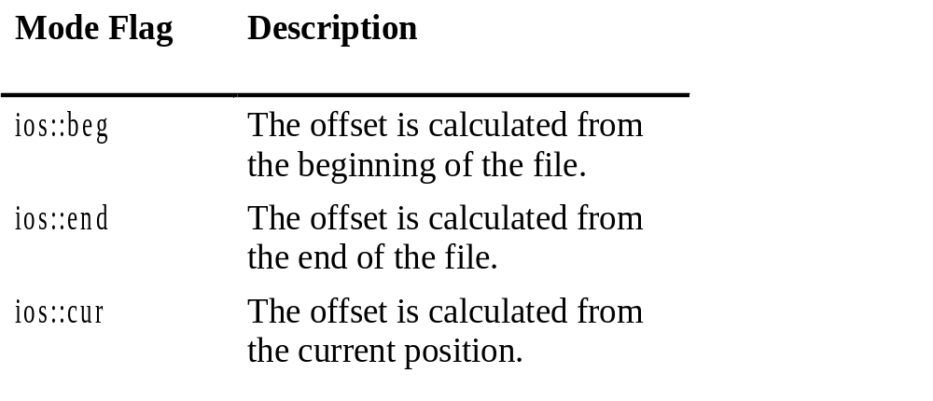
Table 7

Slide 87
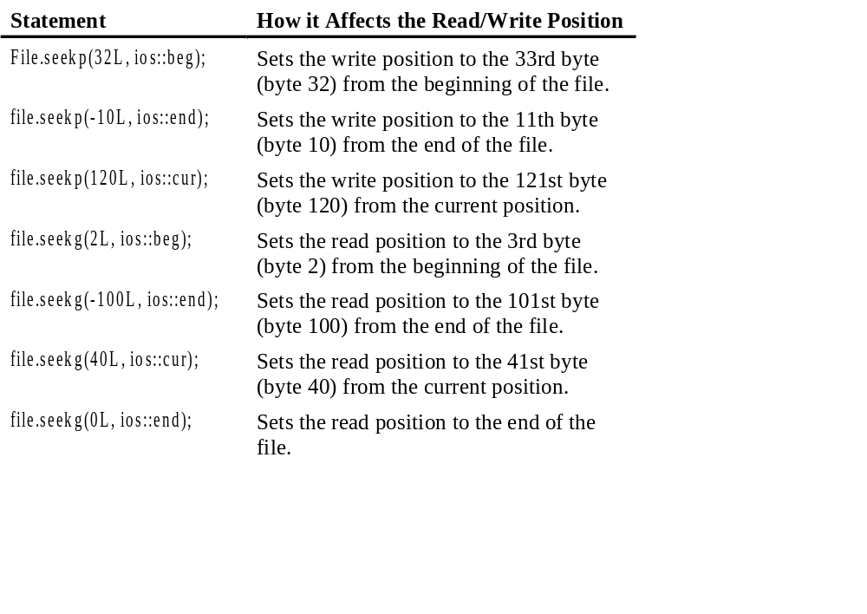
Table 8

Slide 88
Program 21
// This program demonstrates the seekg function.
#include <iostream.h>
#include <fstream.h>
void main(void)
{
fstream file("letters.txt", ios::in);
char ch;
file.seekg(5L, ios::beg);
file.get(ch);
cout << "Byte 5 from beginning: " << ch << endl;
file.seekg(-10L, ios::end);
file.get(ch);
cout << "Byte 10 from end: " << ch << endl;

Slide 89
Program continues
file.seekg(3L, ios::cur);
file.get(ch);
cout << "Byte 3 from current: " << ch << endl;
file.close();
}

Slide 90
Program Screen Output
Byte 5 from beginning: f
Byte 10 from end: q
Byte 3 from current: u

Slide 91
The tellp and tellg Member Functions
tellp returns a long integer that is the current byte number of the file’s write position.
tellg returns a long integer that is the current byte number of the file’s read position.

Slide 92
Program 23
// This program demonstrates the tellg function.
#include <iostream.h>
#include <fstream.h>
#include <ctype.h> // For toupper
void main(void)
{
fstream file("letters.txt", ios::in);
long offset;
char ch, again;
do
{
cout << "Currently at position " << file.tellg() << endl;
cout << "Enter an offset from the beginning of the file: ";
cin >> offset;

Slide 93
Program continues
file.seekg(offset, ios::beg);
file.get(ch);
cout << "Character read: " << ch << endl;
cout << "Do it again? ";
cin >> again;
} while (toupper(again) == 'Y');
file.close();
}

Slide 94
Program Output with Example Input
Currently at position 0
Enter an offset from the beginning of the file: 5 [Enter]
Character read: f
Do it again? y [Enter]
Currently at position 6
Enter an offset from the beginning of the file: 0 [Enter]
Character read: a
Do it again? y [Enter]
Currently at position 1
Enter an offset from the beginning of the file: 20 [Enter]
Character read: u
Do it again? n [Enter]

Slide 95
Opening a File for Both Input and Output
You may perform input and output on an fstream file without closing it and reopening it.
fstream file(“data.dat”, ios::in | ios::out);

Slide 96
Program 24
// This program sets up a file of blank inventory records.
#include <iostream.h>
#include <fstream.h>
// Declaration of Invtry structure
struct Invtry
{
char desc[31];
int qty;
float price;
};
void main(void)
{
fstream inventory("invtry.dat", ios::out | ios::binary);
Invtry record = { "", 0, 0.0 };

Slide 97
Program continues
// Now write the blank records
for (int count = 0; count < 5; count++)
{
cout << "Now writing record " << count << endl;
inventory.write((char *)&record, sizeof(record));
}
inventory.close();
}

Slide 98
Program Screen Output
Now writing record 0
Now writing record 1
Now writing record 2
Now writing record 3
Now writing record 4

Slide 99
Program 25
// This program displays the contents of the inventory file.
#include <iostream.h>
#include <fstream.h>
// Declaration of Invtry structure
struct Invtry
{
char desc[31];
int qty;
float price;
};
void main(void)
{
fstream inventory("invtry.dat", ios::in | ios::binary);
Invtry record = { "", 0, 0.0 };

Slide 100
Program continues
// Now read and display the records
inventory.read((char *)&record, sizeof(record));
while (!inventory.eof())
{
cout << "Description: ";
cout << record.desc << endl;
cout << "Quantity: ";
cout << record.qty << endl;
cout << "Price: ";
cout << record.price << endl << endl;
inventory.read((char *)&record, sizeof(record));
}
inventory.close();
}

Slide 101
Here is the screen output of Program 25 if it is run immediately after Program 24 sets up the file of blank records.
Program Screen Output
    Description:
    Quantity: 0
    Price: 0.0
    Description:
    Quantity: 0
    Price: 0.0
    Description:
    Quantity: 0
    Price: 0.0
    Description:
    Quantity: 0
    Price: 0.0
    Description:
    Quantity: 0
    Price: 0.0

Slide 102
Program 26
// This program allows the user to edit a specific record in
// the inventory file.
#include <iostream.h>
#include <fstream.h>
// Declaration of Invtry structure
struct Invtry
{
char desc[31];
int qty;
float price;
};
void main(void)
{

Slide 103
Program continues
fstream inventory("invtry.dat", ios::in | ios::out | ios::binary);
Invtry record;
long recNum;
cout << "Which record do you want to edit?";
cin >> recNum;
inventory.seekg(recNum * sizeof(record), ios::beg);
inventory.read((char *)&record, sizeof(record));
cout << "Description: ";
cout << record.desc << endl;
cout << "Quantity: ";
cout << record.qty << endl;
cout << "Price: ";
cout << record.price << endl;
cout << "Enter the new data:\n";
cout << "Description: ";

Slide 104
Program continues
cin.ignore();
cin.getline(record.desc, 31);
cout << "Quantity: ";
cin >> record.qty;
cout << "Price: ";
cin >> record.price;
inventory.seekp(recNum * sizeof(record), ios::beg);
inventory.write((char *)&record, sizeof(record));
inventory.close();
}

Slide 105
Program Screen Output with Example Input
Which record do you ant to edit? 2 [Enter]
Description:
Quantity: 0
Price: 0.0
Enter the new data:
Description: Wrench [Enter]
Quantity: 10 [Enter]
Price: 4.67 [Enter]

